Slide 1


Words from the Lord
1 Corinthians 14:1-25
Dr. Rick Griffith • Crossroads International Church Singapore
cicfamily.com & BibleStudyDownloads.org

Slide 2
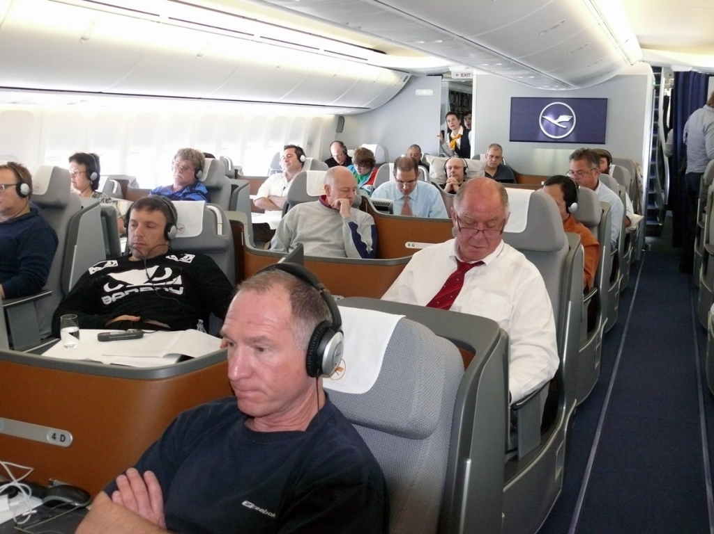
Bill Gates
Notes:
2

Slide 3
God Speaks
Notes:
3

Slide 4
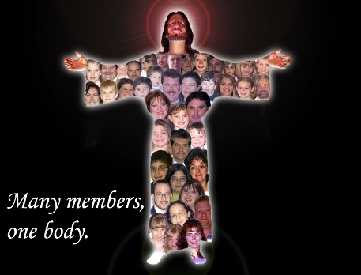

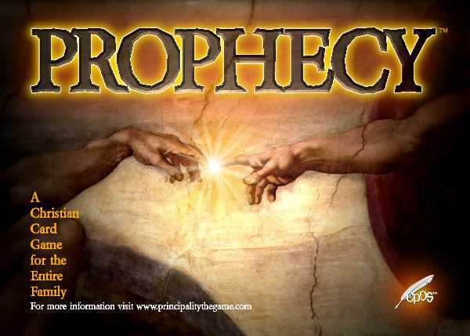

Gifts in 1 Corinthians 12–14
12
13
14
over
LOVE
TONGUES

Slide 5
Let love be your highest goal! But you should also desire the special abilities the Spirit gives–especially the ability to prophesy
(14:1 NLT)

Slide 6
Main Idea
We edify in public worship by emphasizing prophecy over tongues
14
over
TONGUES
Notes:
6

Slide 7
But why emphasize prophecy over tongues?
over
3 reasons
TONGUES
Notes:
7

Slide 8
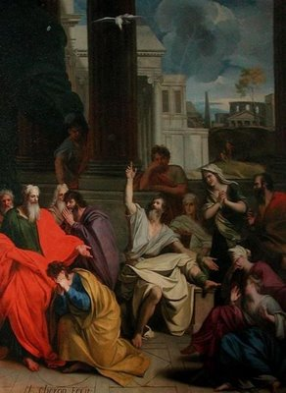
I. Prophecy benefits other believers (2-5)
Notes:
8

Slide 9

A. Prophecy is understood by others while tongues is understood only by God (2-3).
²For if you have the ability to speak in tongues, you will be talking only to God,
since people won't be able to understand you. You will be speaking by the power of the Spirit, but it will all be mysterious.
³But one who prophesies strengthens others, encourages them, and comforts them (NLT).
Notes:
9

Slide 10
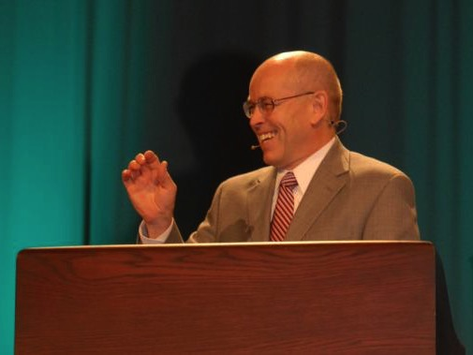
Wayne Grudem's Definition of Prophecy
“telling something that God has spontaneously brought to mind”
“Why Christians Can Still Prophesy” Christianity Today (16 Sept 1988), 29

Slide 11

PROPHECY
“the special ability to receive revelation from God and communicate this in an immediate message to His people by speaking His words without error”

Slide 12
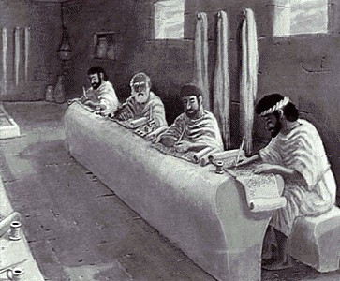
Why Are Requirements of True Prophecy Necessary?
186
God's character demands that he speak only truth.
False prophets were executed (Deut. 18:21-22).

Slide 13
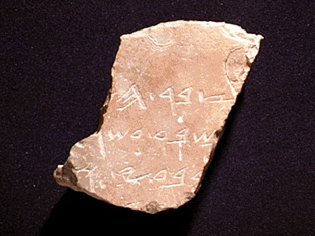
Definitions
186
Hebrew: nabi
a mouthpiece for God
“spokesman, speaker, prophet”
Greek:
prophetes
“one who speaks for God, proclaiming what God wants to make known”

Slide 14

Tests of a True Prophet (Deut. 18:20, 22)
Predictions 100% true
Worships the LORD
“But any prophet who falsely claims to speak in my name or who speaks in the name of another god must die…If the prophet speaks in the Lord's name but his prediction does not happen or come true, you will know that the Lord did not give that message. That prophet has spoken without my authority and need not be feared.”

Slide 15
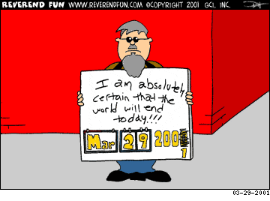
False prophecies change

Slide 16

Prophecy is Not Interpreted
“knowing this first of all, that no prophecy of Scripture comes from someone's own interpretation. For no prophecy was ever produced by the will of man, but men spoke from God as they were carried along by the Holy Spirit”
2 Peter 1:20-21 (ESV)

Slide 17

God's Household (Eph. 2:19-22)
19
Non-Equipping Gifts
(Eph. 4:12b)
Pastor-Teachers
Evangelists
Teachers
Equipping Gifts
(Eph. 4:11-12a)
Foundation: Apostles & Prophets (Eph. 2:20)
Foundation: The Lord Jesus Christ (1 Cor. 3:11)
Adapted from Charles R. Swindoll. “Spiritual Gifts Study Guide” (IFL, 1983), 7

Slide 18

A Stern Warning (Rev. 22:18-19)
“I warn everyone who hears the prophecy of this book:
If anyone adds anything to them, God will add to him the plagues described in this book.
If anyone takes words away from this book of prophecy, God will take away from him his share in the tree of life and the holy city, which are described in this book”

Slide 19
My Friend Henry
Notes:
19

Slide 20
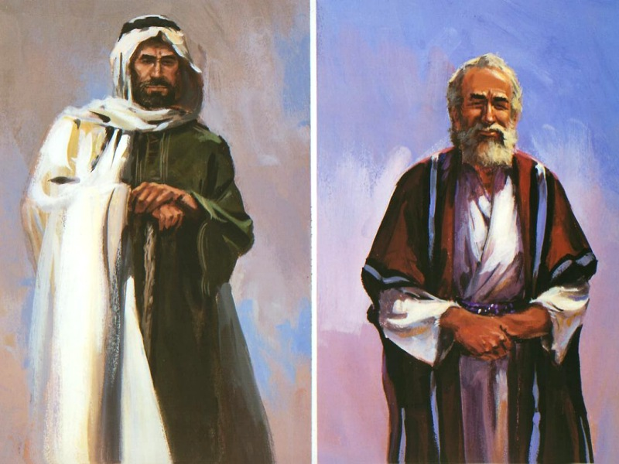
The Two Witnesses (Rev. 11:3)
And I will give power to my two witnesses, and they will be clothed in burlap and will prophesy during those 1,260 days.

Slide 21

How does tongues differ from prophecy?

Slide 22
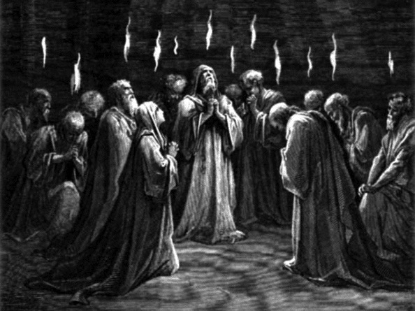
The Spirit Came at Pentecost (Acts 2)

Slide 23
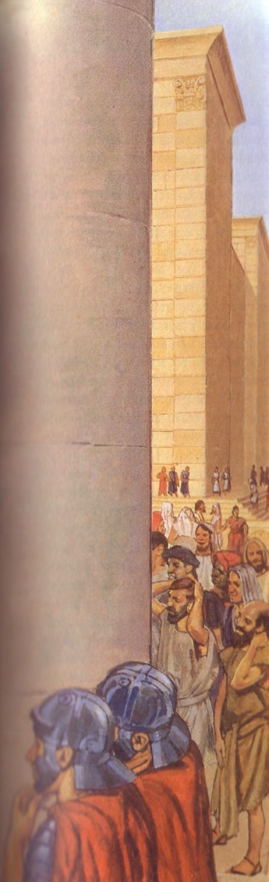
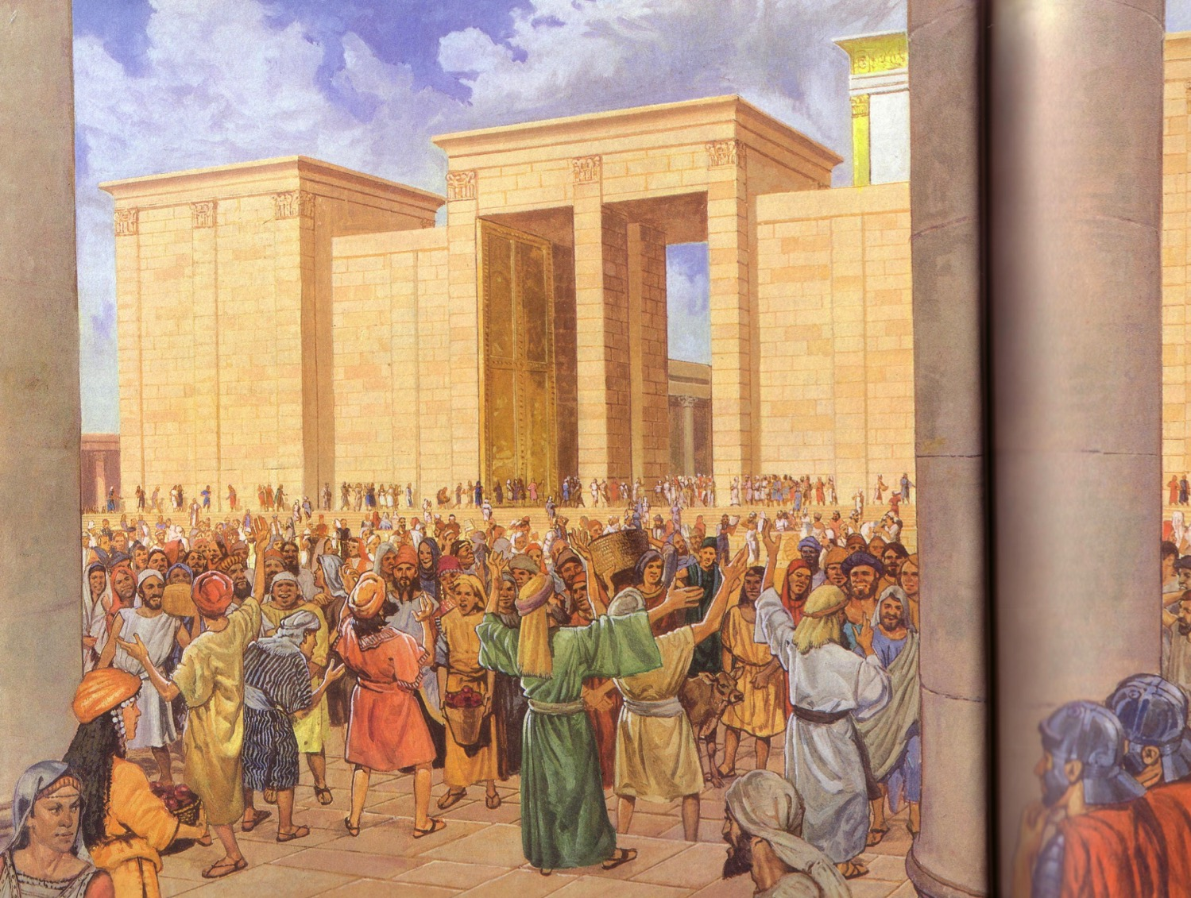
Apostles praised God in languages they had never learned (Acts 2)
Egyptian
Persian
Arabic
Median
Latin
Etc.

Slide 24
A. Prophecy is understood by others while tongues is understood only by God (2-3).
²For if you have the ability to speak in tongues, you will be talking only to God,
since people won't be able to understand you. You will be speaking by the power of the Spirit, but it will all be mysterious.
³But one who prophesies strengthens others, encourages them, and comforts them (NLT).
Notes:
24

Slide 25
Tongues Comparisons
33
Tongues in… | Acts | 1 Corinthians
Both were known foreign languages | Languages of the Roman world were spoken (Acts 2:7-11) | The same word (glossa) is used, so the nature of the gift is the same (Rom. 3:13; 14:11; Phil. 2:11 all refer to intelligible speech)
Both functioned as a sign to unbelievers | Listeners were exhorted to receive forgiveness (Acts 2:38) | Unbelievers in the assembly needed translation for blessing (1 Cor.14:21-22)
Both have God as the Source rather than self | The tongues speakers were not trying to get the gift (Acts 2:2) | Tongues is among the gifts of the Spirit (1 Cor. 12–14)
Notes:
25

Slide 26
B. Prophecy edifies the church while tongues only edifies the speaker (4-5).
⁴A person who speaks in tongues is strengthened personally, but one who speaks a word of prophecy strengthens the entire church.
⁵I wish you could all speak in tongues, but even more I wish you could all prophesy. For prophecy is greater than speaking in tongues, unless someone interprets what you are saying so that the whole church will be strengthened (NLT).
Notes:
26

Slide 27
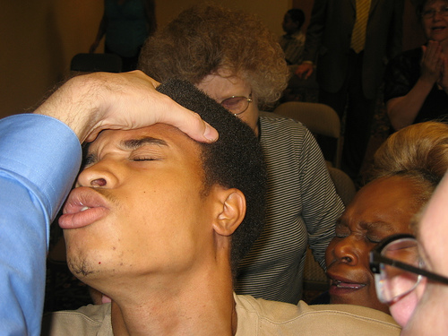
II. Uninterpreted tongues are incomprehensible (6-19)
Notes:
27

Slide 28
Tongues benefit no one unless they reveal God's will (1 Cor. 14:6 NAU)
6 But now, brethren, if I come to you speaking in tongues, what will I profit you unless I speak to you either by way of revelation or of knowledge or of prophecy or of teaching?

Slide 29
Tongues without interpretation don’t communicate like musical instruments that don’t distinguish notes (14:7-9 NAU).
7 Yet even lifeless things, either flute or harp…if they do not produce a distinction in the tones, how will it be known what is played on the flute or on the harp? 8 For if the bugle produces an indistinct sound, who will prepare himself for battle? 9 So also you, unless you utter by the tongue speech that is clear, how will it be known what is spoken? For you will be speaking into the air.

Slide 30
Emphasize intelligible gifts more than uninterpreted tongues (14:10-12 NAU)
10 There are, perhaps, a great many kinds of languages in the world, and no kind is without meaning. 11 If then I do not know the meaning of the language, I will be to the one who speaks a barbarian, and the one who speaks will be a barbarian to me. 12 So also you, since you are zealous of spiritual gifts, seek to abound for the edification of the church.

Slide 31
Prayer and singing are superior only when understood because this edifies people (14:13-17 NAU)
13 Therefore let one who speaks in a tongue pray that he may interpret. 14 For if I pray in a tongue, my spirit prays, but my mind is unfruitful. 15 What is the outcome then? I will pray with the spirit and I will pray with the mind also; I will sing with the spirit and I will sing with the mind also.

Slide 32
Prayer and singing are superior only when understood because this edifies people (14:13-17 NAU)
16 Otherwise if you bless in the spirit only, how will the one who fills the place of the ungifted say the “Amen” at your giving of thanks, since he does not know what you are saying? 17 For you are giving thanks well enough, but the other person is not edified.

Slide 33
A little understandable prophecy is better than a lot of incomprehensible tongues (14:18-19 NAU)
18 I thank God, I speak in tongues more than you all; 19 however, in the church I desire to speak five words with my mind so that I may instruct others also, rather than ten thousand words in a tongue.

Slide 34
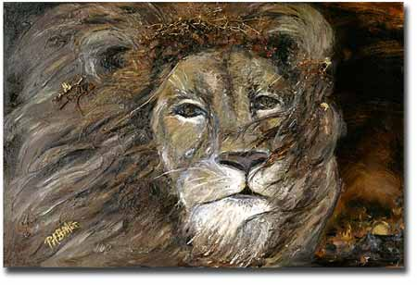
III. Prophecy has a superior purpose and results (20-25).
Notes:
34

Slide 35
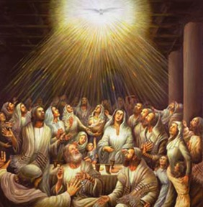
A. Prophecy has a superior purpose (20-22).
Tongues authenticate God's work to unbelievers (21-22a)
Notes:
35

Slide 36
Purpose for Jewish Unbelievers
In the Law it is written:
“Through men of strange tongues and through the lips of foreigners I will speak to this people [Jews], but even then they will not listen to me,” says the Lord.
Tongues, then, are a sign, not for believers but for unbelievers;
prophecy, however, is for believers,
not for unbelievers.
1 Corinthians 14:21-22
Notes:
36

Slide 37

A Biblical Definition of Tongues
29
“The God-given ability to speak divine revelation in a foreign language by the speaker to unbelieving Jews in their language as a sign that a gifted interpreter can translate to edify the church”
Notes:
37

Slide 38
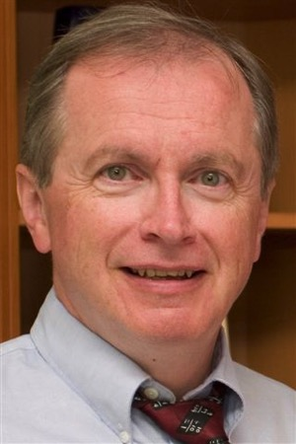
Modern Tongues are Not Languages
“To my knowledge there is universal agreement among linguists who have taped and analyzed thousands of examples of modern tongues-speaking that the contemporary phenomenon is not any human language.
“The patterns and structures that all known languages require are simply not there. Occasionally a recognizable word slips out; but this is statistically likely, given the sheer quantity of verbalization.”
D. A. Carson, Showing the Spirit, 83
Notes:
38

Slide 39
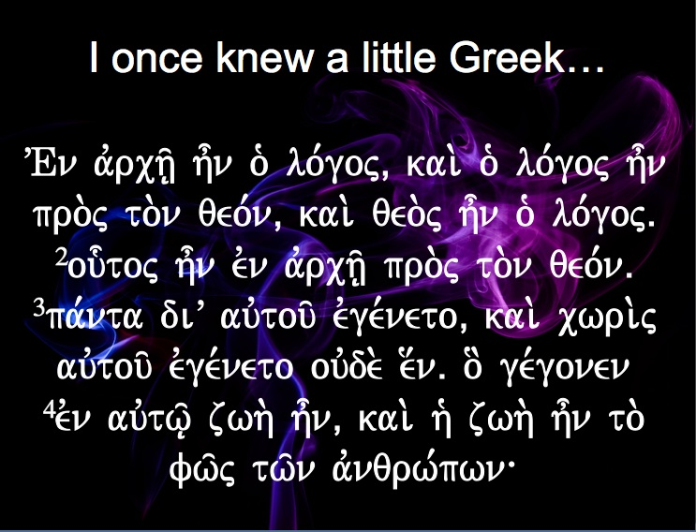

I once knew a little Greek…
VEn avrch/| h=n o` lo,goj( kai. o` lo,goj h=n pro.j to.n qeo,n( kai. qeo.j h=n o` lo,gojÅ
²ou-toj h=n evn avrch/| pro.j to.n qeo,nÅ
³pa,nta diV auvtou/ evge,neto( kai. cwri.j auvtou/ evge,neto ouvde. e[nÅ o] ge,gonen
⁴evn auvtw/| zwh. h=n( kai. h` zwh. h=n to. fw/j tw/n avnqrw,pwn\

Slide 40
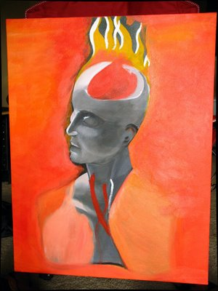
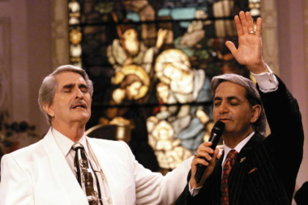
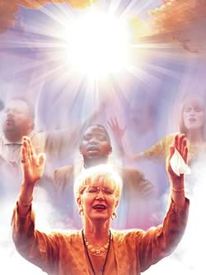
Today:
Real Languages?
For Unbelievers?
Notes:
40

Slide 41

Why can't tongues be a special prayer language?
31
Edifies others (14:26)
For unbelievers (14:22)
Not understood (14:14-15)
Limited to some (12:30)
Interpretation required (14:26-28)
Keep quiet in the church (14:28)
Outside church as a sign (14:20)

Slide 42
A. Prophecy has a superior purpose (20-22).
Far superior is prophecy, for prophecy edifies believers (22b)
Tongues authenticate God's work to unbelievers (21-22a)
Notes:
42

Slide 43
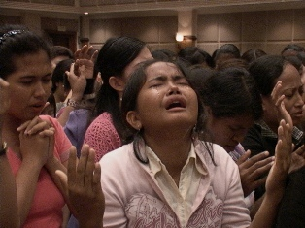
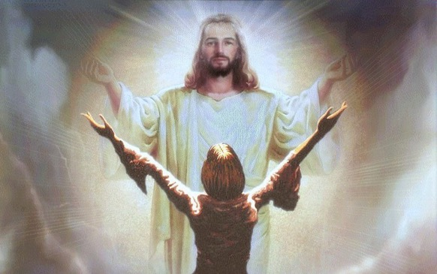
B. Prophecy has superior results (23-25).
But prophecy brings conviction, repentance, and worship for unbelievers in the assembly (24-25)
Uninterpreted tongues turns off unbelievers in the assembly (23)
Notes:
43

Slide 44

God's Word must have the highest priority in public worship (Main Idea)
Home group
Life Transformation Groups (LTGs)
Take notes
Bring a Bible
“No Bible,
no breakfast”

Slide 45
Black
Notes:
45

Slide 46


NT Preaching link at BibleStudyDownloads.org
Get this presentation and script for free!
Notes:
NT Preaching (np)

